Slide 1

Restaurants(Berlin) By: Jennipher, Anja

Slide 2
Project
which parts of the city have the most restaurants per sq km?
where can a vegan burger restaurant be found, with an opening time filter eg customer wants to visit on Thursday at 6pm?
how many Vietnamese restaurants are there in Berlin?
U: which restaurants are good for big groups?

Slide 3
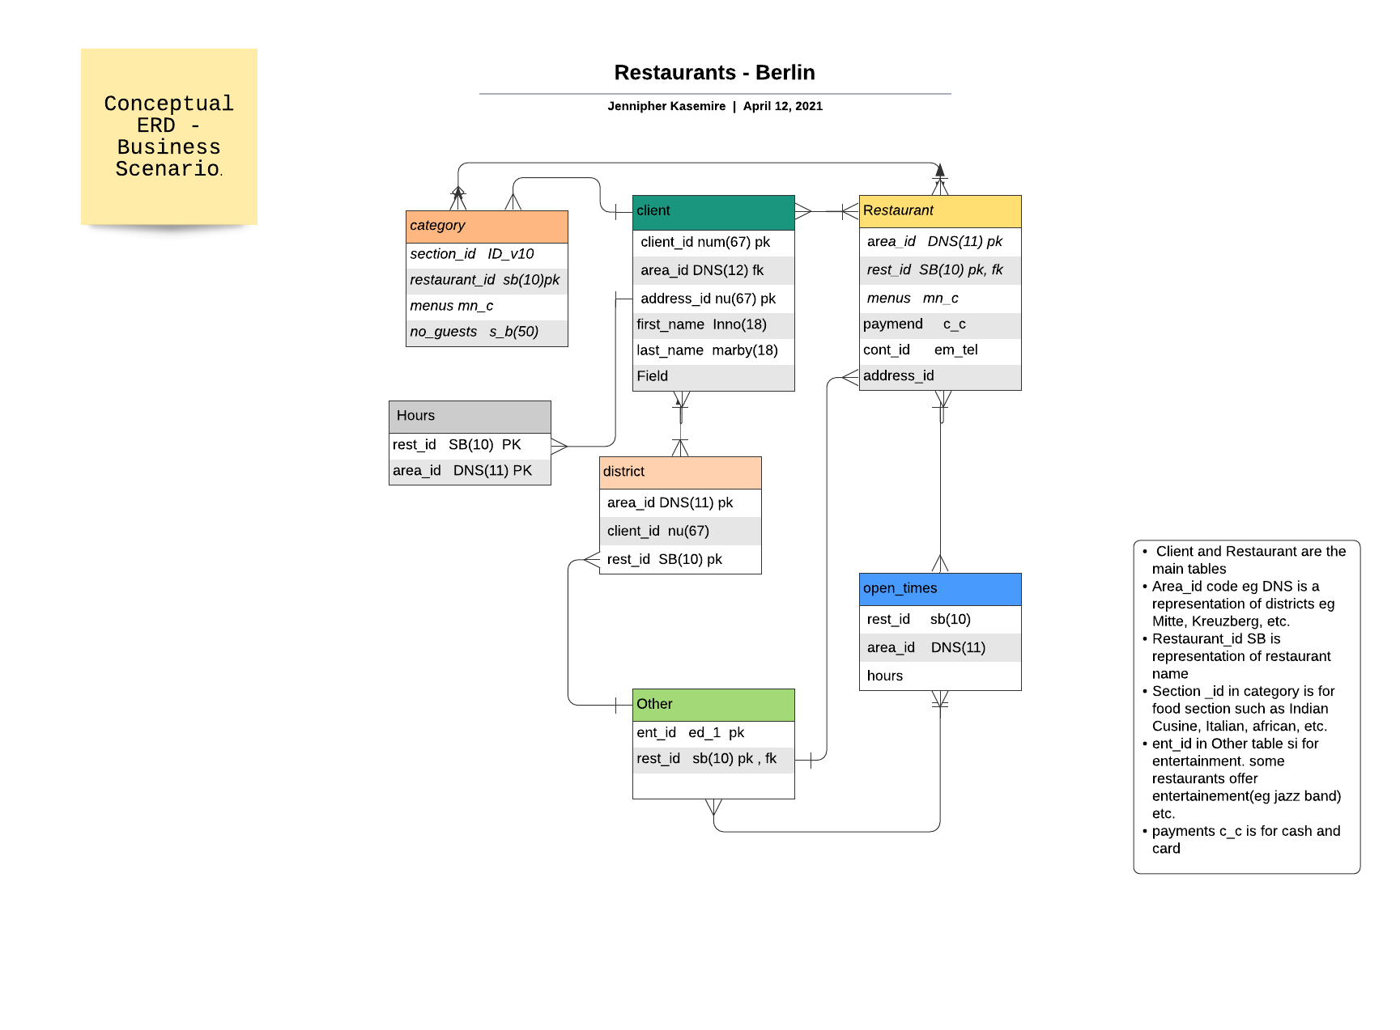

Slide 4
Challenges
Struggled with visualisation templates online
Time Constrained
In Future;
Make it more visually appealing (better design)
Add more keys eg menu, reviews, contacts etc
Collaborate with others on such a project
Manage Time better

